Slide 1
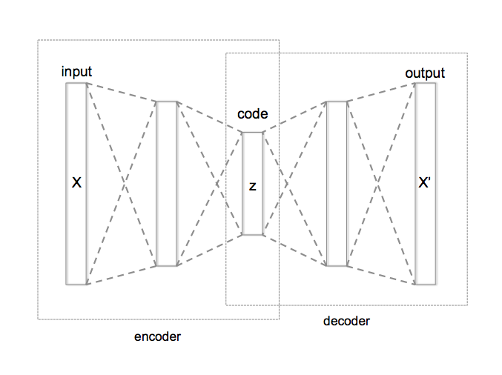
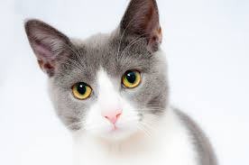
Auto encoders are a type of Artificial Neural Networks that are used to perform a task of data encoding (representation learning). Auto encoders use the same input data for the input and output, Sounds crazy right!?
AUTOENCODERS INTUITION
TARGET (TRUE)
LABEL
ENCODED CAT IMAGE

Slide 2
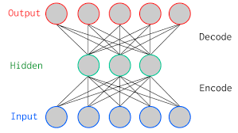
THE CODE LAYER
Auto encoders work by adding a bottleneck in the network.
This bottleneck forces the network to create a compressed (encoded) version of the original input
Auto encoders work well if correlations exists between input data (performs poorly if the all input data is independent)
BOTTLENECK
“CODE LAYER”
(i.e.: ENCODED CAT IMAGE)
ENCODER
DECODER

Slide 3
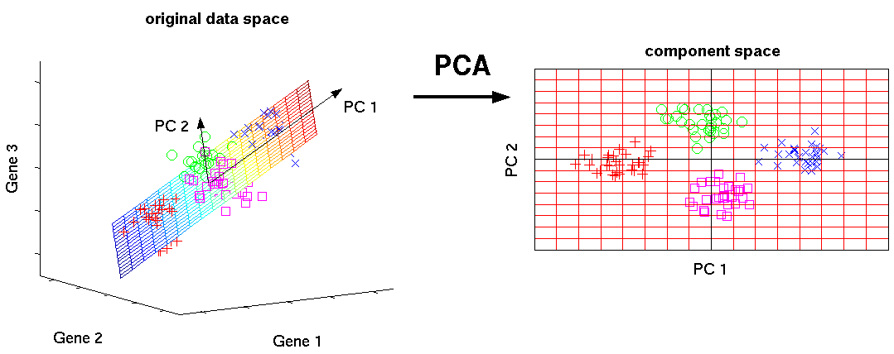
PRINCIPAL COMPONENT ANALYSIS: OVERVIEW
PCA is an unsupervised machine learning algorithm.
PCA performs dimensionality reductions while attempting at keeping the original information unchanged.
PCA works by trying to find a new set of features called components.
Components are composites of the uncorrelated given input features.

